Slide 1
Control Charts-based Trading Strategies for Cryptocurrency and Stock indices
Course: Data Analytics and Systems Monitoring – Fall 2021
Weihang Ren Babak Ahmadi

Slide 2
Agenda
1. Problem Statement
2. Literature Review
3. Explanation of Methods:
a) How to deal with the autocorrelation in our data?
b) CUSUM (With/Without Transaction Fees)
i) Montgomery model
ii) The CUSUM model in literature
c) EWMA
d) risk-adjusted CUSUM on stock price
4. Results
a) Explain our Data
b) Observed results for each method discussed
c) Results of risk-adjusted CUSUM model for stock prices
d) Back test
5. Findings and Insights
6. References
2/34

Slide 3
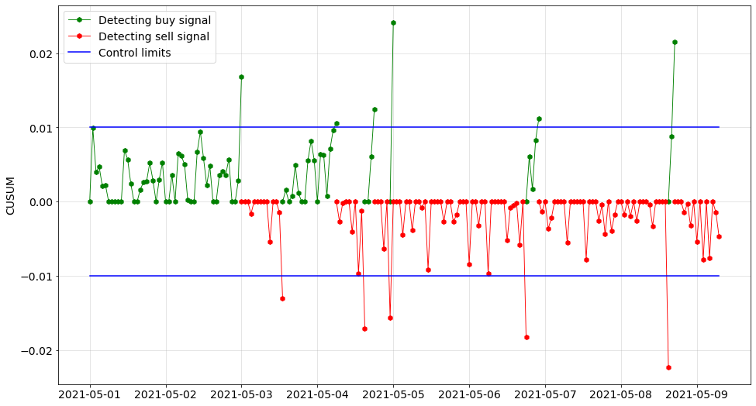


Is it possible to determine some strategies by control charts to trade and make profit? If yes, which control chart or method works the best? Our focus is on the application of Control Charts in Cryptocurrency and stock prices.
Problem
3/34

Slide 4



Motivation for Cryptocurrency: Basically, a cryptocurrency is a digital or virtual currency [1] that is secured by cryptography, which makes it nearly impossible to counterfeit or double-spend. Many cryptocurrencies are decentralized networks based on blockchain [2] technology—a distributed ledger enforced by a disparate network of computers. A defining feature of cryptocurrencies is that they are generally not issued by any central authority, rendering them theoretically immune to government interference or manipulation [3]. As we all know, Cryptocurrency is one of the most controversial topics nowadays and we want to see if we can use the control charts to make money/profit in this hot market.
Motivation
Motivation for Risk-Adjusted CUSUM: By applying risk-adjusted monitoring method, we try to reveal factors that affect the stock price which is exclusive to the company instead of the whole industry, which for sure is better than the fundamental analysis
4/34

Slide 5
Literature
Paper | Main Focus/Idea/Methods | Connections/Differences | Comments
[4]. Harry V. Roberts. Stock-market “patterns” and financial analysis: methodological suggestions | First paper that used SPC methods to study changes in stock market price levels. | No trading rules | First comments in this field: Set up control limits to aid visualize analysis in the future. If a point falls outside the control limits, this gives a signal for analyst.
[5]. Charles L. Hubbard. A control chart for postwar stock price levels. | Determined stock price trend and compared it with gross national product (GNP) and personal income trends. Set up decision rules for buying or holding stocks. | Proposed a decision rule based on sell and buy signals. | The used data is monthly values of 200 stock average from 1950 to 1967.
Alexander S. S. [6]. Price movements in speculative markets: trends or random walks. [7]. Price movements in speculative markets-trends or random walks, number 2. | Introduced the filter trading rules. Filter trading rule is defined as a sequence of signals for buying and selling stocks. Buy signal: for example, the daily closing price of a stock moves up at least a certain percent x from a subsequent low. x here is the filter size for the trading rule. | Calculated profits from various filter sizes and compared them with buy and hold strategy. | Findings in these papers can be summarized as: Price changes appear to follow a random walk over time, but a move, once initiated, tends to persist.
5/34

Slide 6
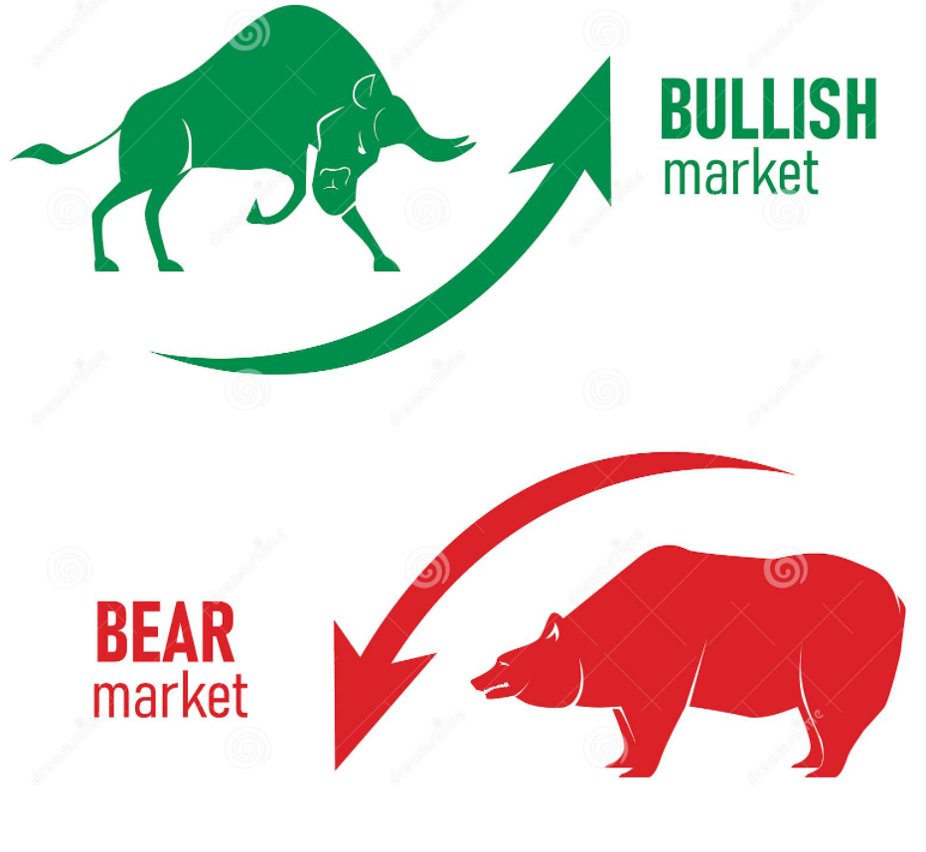
Literature
Paper | Main Focus/Idea/Methods | Connections/Differences | Comments
[8]. Kin Lam, H. C. Yam. CUSUM techniques for technical trading in financial markets. | Motivated by the filter trading rule, used CUSUM to create a trading strategy (equivalent to filter trading rule) in the stock market. a) k=0, h=log(1+x) x: filter size of trading rule= b) Then generalized the classical filter trading rule: k≠0 First, they considered general CUSUM procedure (k>0, h=0) | First Trading Strategy based on CUSUM method. Worked on different scenarios for k and h. | Main drawback of the general filter trading rule (k>0, h=0): Absence of a stop-loss mechanism.
[9]. G.Yi, S. Coleman & Q. Ren CUSUM method in predicting regime shifts and its performance in different stock markets allowing for transaction fees. | CUSUM techniques in predicting regime shifts (between bullish and bearish) + transaction fees. Performance of each k and h is measured by Total Profit and Daily Profit. | Considering transaction fees in contrast with Lam, Yam. for the first time in CUSUM papers. | Result of considering transaction fees was Deterioration of CUSUM (No acceptable k and h)
6/34

Slide 7
Literature
Paper | Main Focus/Idea/Methods | Connections/Differences | Comments
[10]. Berislav Žmuk. Capabilities of statistical residual-based control charts in short-and long-term stock trading. | Applied residual based control charts to improve decision making in stock trading. Used open and average price of index stocks. 3 control charts are used in this paper: a) Individual units (I-chart) b) EWMA c) CUSUM | Used ARIMA model to deal with autocorrelation in the data. | As a result of applying ARIMA model, residual-based CUSUM has the highest investor trading score.
[11]. Ling Xin, Philip L.H. Yu, Kin Lam An application of CUSUM chart on financial trading | Used CUSUM control charts under the spectrum of filter trading rule. Proposed to use a Markov Chain approach to compute the profit of the filter trading rule. In Two regime model, security returns have different distributions. Market transits between bear and bull state (The Two-regimes). | Reference value (k)=0 Means: filter trading rule monitors whether stock return series belongs to a bull or bear market. | The performance of the filter trading rule under the filter size that gives the largest expected unit time profit, is profitable. The annualized log-returns of filter trading rule outperforms the log-returns of the buy-and-hold strategy.
7/34

Slide 8
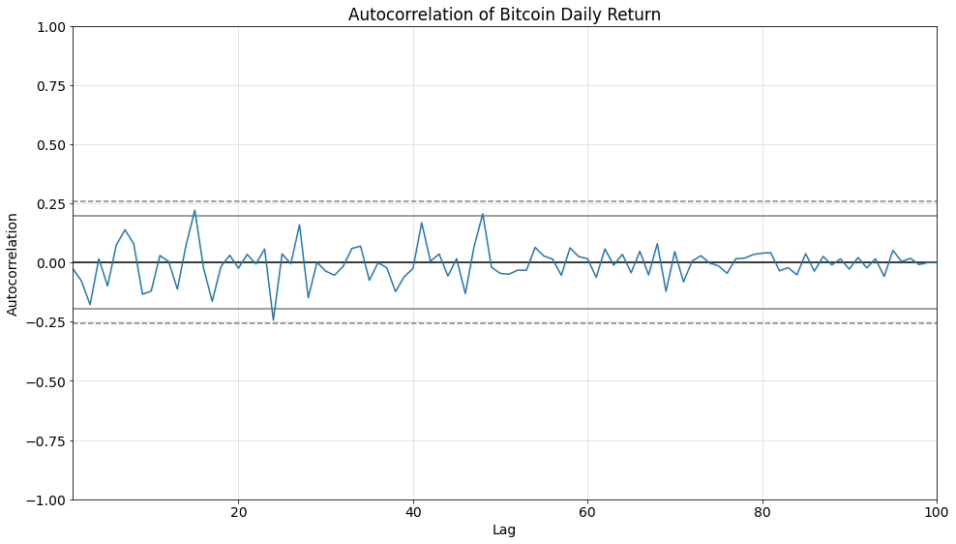
Cryptocurrency, like the stock market prices are clearly autocorrelated. We considered two procedures to deal with this autocorrelation: 1. Calculate and use Return Values of each coin, which is not auto-correlated.
Methods
Deal with Auto-correlated data:
8/34

Slide 9
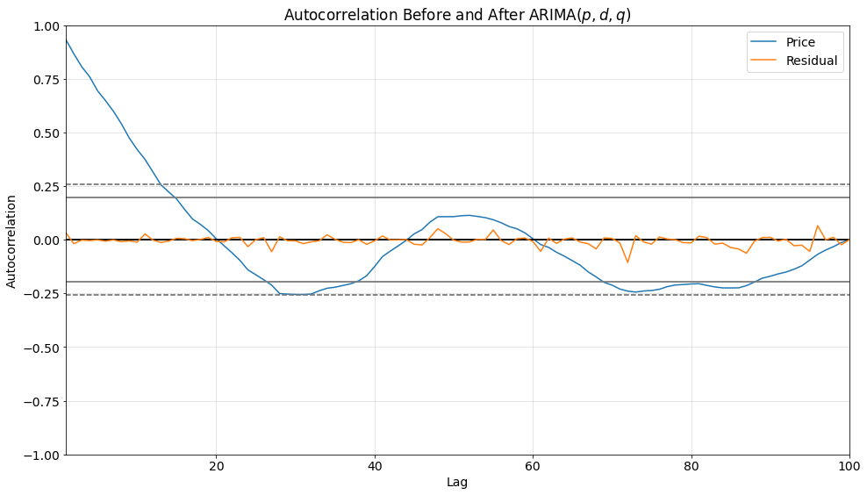
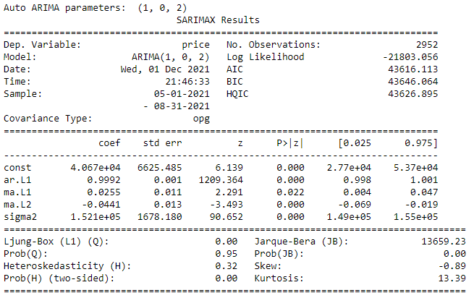
Deal with Auto-correlated data-Cont’d:
Methods
2. Another procedure we use to deal with this auto-correlated data is using ARIMA. Find the best AR and MA parameters for our case. Implement CUSUM model on the residuals [10]. (Call this model as Residual-based CUSUM model). Auto ARIMA considers the AIC and BIC values generated to determine the best combination of parameters. AIC (Akaike Information Criterion) and BIC (Bayesian Information Criterion) values are estimators to compare models. The lower these values, the better is the model.
9/34

Slide 10
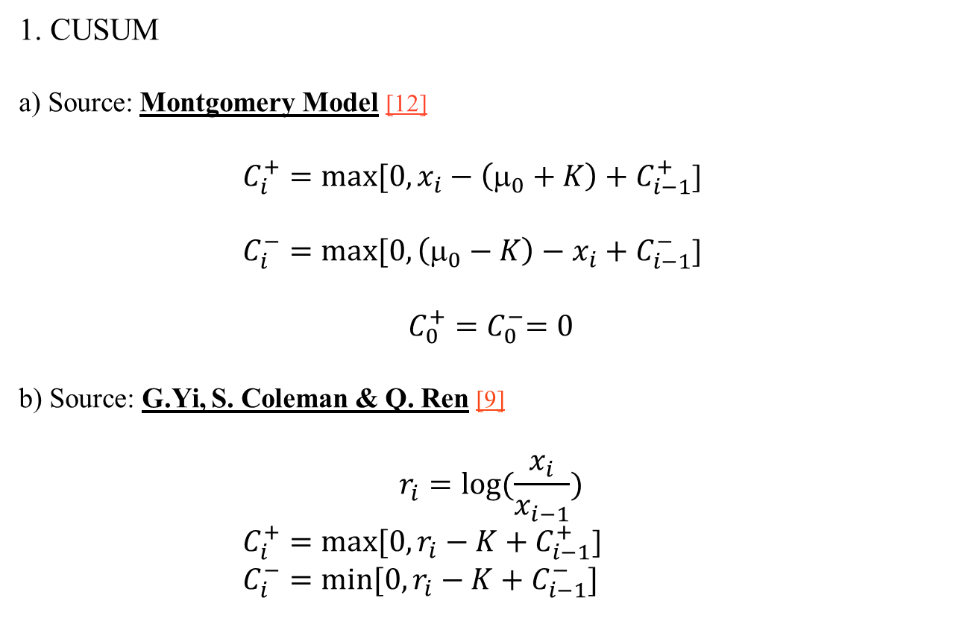
1. CUSUM a) Source: Montgomery Model [12] $C_{i}^{+}=max⁡[0, x_{i}−\left(μ_{0}+K\right)+C_{i−1}^{+}$] $C_{i}^{−}=max⁡[0,\left(μ_{0}−K\right)−x_{i}+C_{i−1}^{−}$] $$C_{0}^{+}{=C}_{0}^{−}=0$$ b) Source: G.Yi, S. Coleman & Q. Ren [9] $$r_{i}=log⁡(\frac{x_{i}}{x_{i−1}})$$ $C_{i}^{+}=max⁡[0,r_{i}−K+C_{i−1}^{+}$] $C_{i}^{−}=\min{[0,r_{i}−K+C_{i−1}^{−}]}$
Methods
10/34

Slide 11
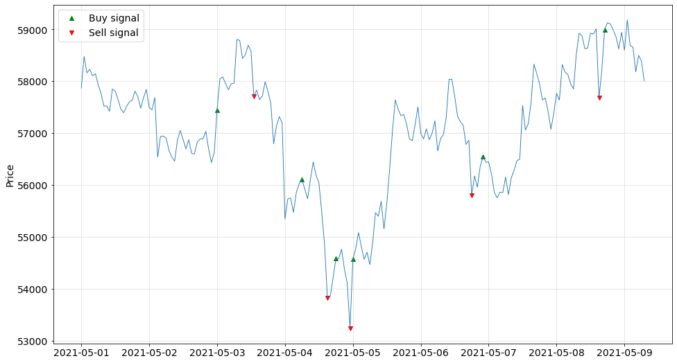
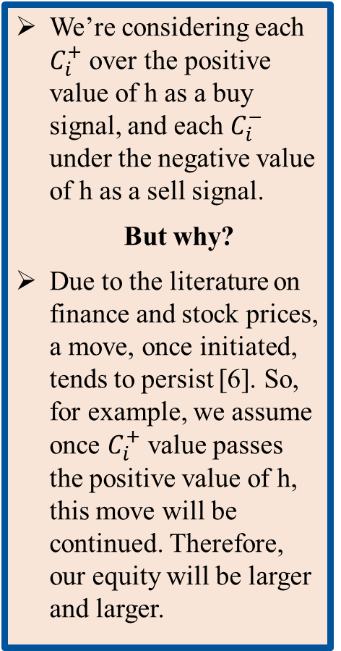
We’re considering each $C_{i}^{+}$ over the positive value of h as a buy signal, and each $C_{i}^{−}$ under the negative value of h as a sell signal.
But why?
Due to the literature on finance and stock prices, a move, once initiated, tends to persist [6]. So, for example, we assume once $C_{i}^{+}$ value passes the positive value of h, this move will be continued. Therefore, our equity will be larger and larger.
11/34

Slide 12
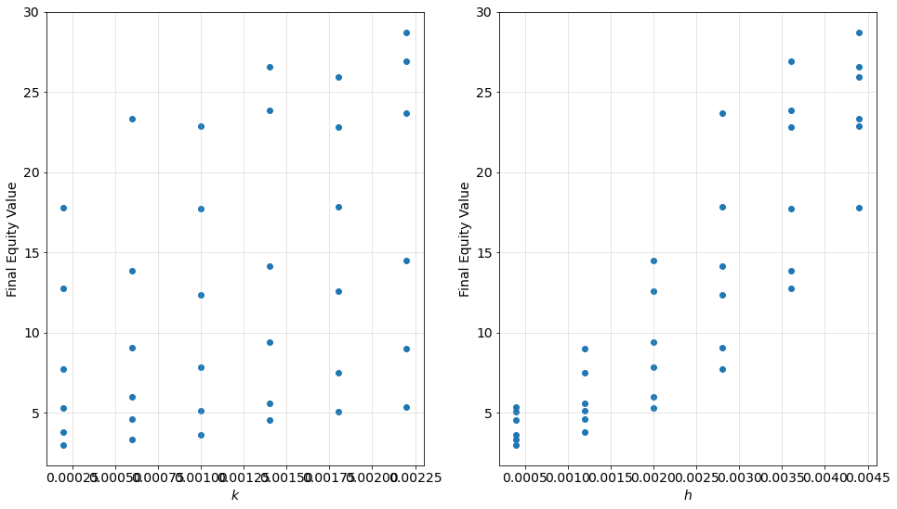
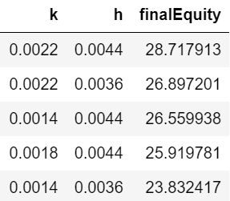
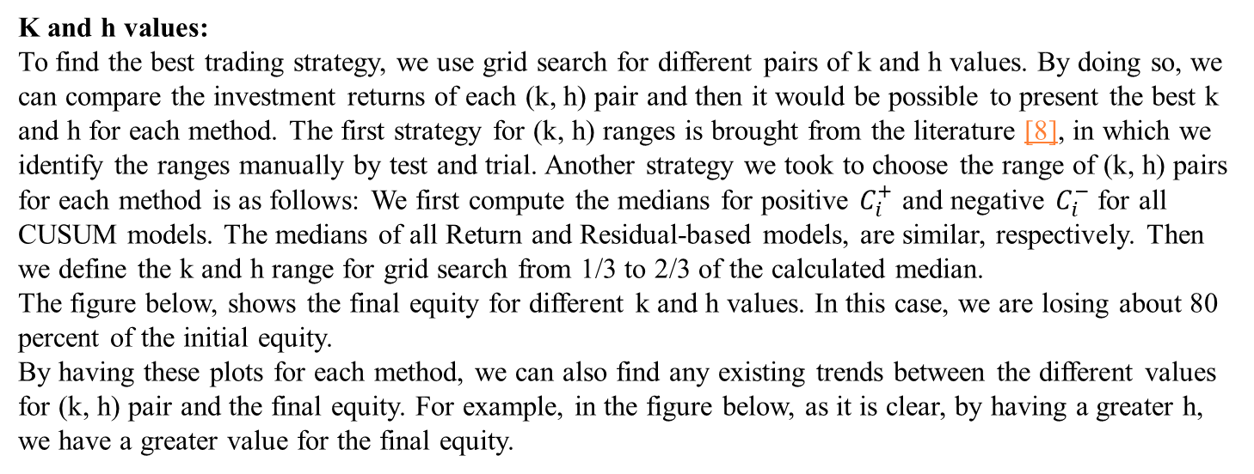
K and h values: To find the best trading strategy, we use grid search for different pairs of k and h values. By doing so, we can compare the investment returns of each (k, h) pair and then it would be possible to present the best k and h for each method. The first strategy for (k, h) ranges is brought from the literature [8], in which we identify the ranges manually by test and trial. Another strategy we took to choose the range of (k, h) pairs for each method is as follows: We first compute the medians for positive $C_{i}^{+}$ and negative $C_{i}^{−}$ for all CUSUM models. The medians of all Return and Residual-based models, are similar, respectively. Then we define the k and h range for grid search from 1/3 to 2/3 of the calculated median. The figure below, shows the final equity for different k and h values. In this case, we are losing about 80 percent of the initial equity. By having these plots for each method, we can also find any existing trends between the different values for (k, h) pair and the final equity. For example, in the figure below, as it is clear, by having a greater h, we have a greater value for the final equity.
Methods
12/34

Slide 13
Most of the related papers in this field, did not consider the transaction fees in their model, but to be more realistic, we consider transaction fees which is currently 0.5% of each buying transaction. We add this transaction fees to our models and compare the profits we make with and without it in the Results section.
Methods
Transaction fees:
Transaction fee in reality:
Coinbase pricing and fees disclosures: 0.50% [13]
13/34

Slide 14
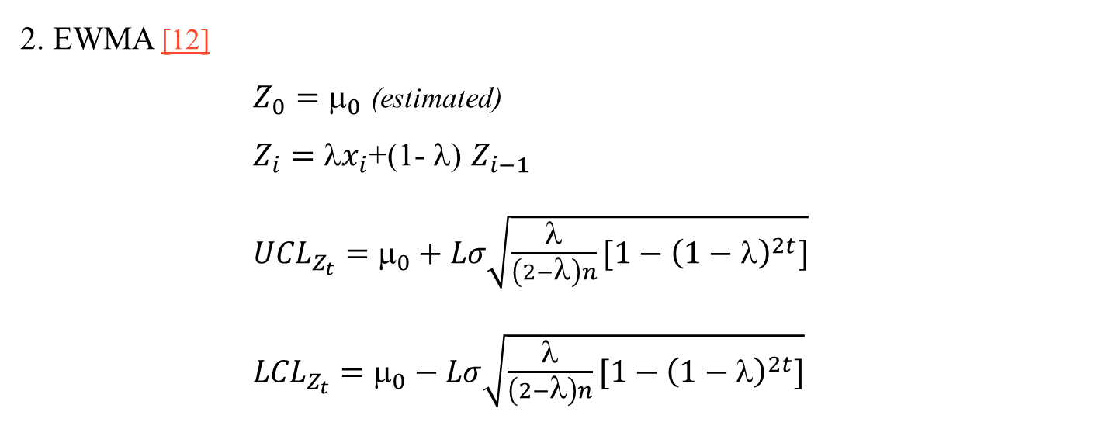
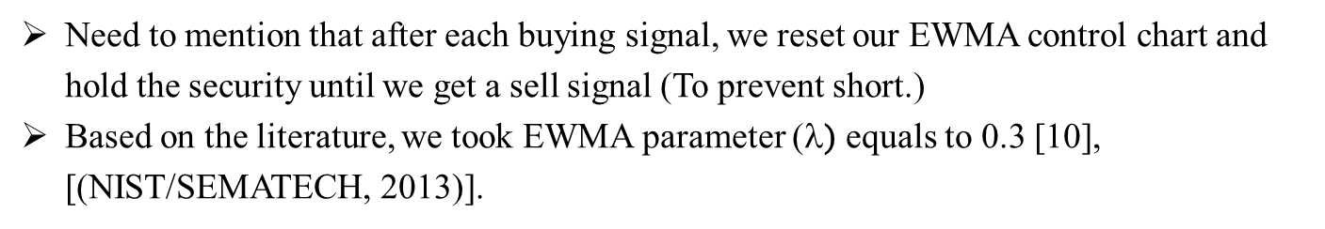
2. EWMA [12] $Z_{0}=$ $_{0}$ (estimated) $Z_{i}=x_{i}$+(1- $$) $Z_{i−1}$ ${UCL}_{Z_{t}}=$ $_{0}+Lσ\sqrt{\frac{λ}{\left(2−λ\right)n}[1−{\left(1−λ\right)}^{2t}]}$ ${LCL}_{Z_{t}}=$ $_{0}−Lσ\sqrt{\frac{λ}{\left(2−λ\right)n}[1−{\left(1−λ\right)}^{2t}]}$
Methods
Need to mention that after each buying signal, we reset our EWMA control chart and hold the security until we get a sell signal (To prevent short.)
Based on the literature, we took EWMA parameter ($$) equals to 0.3 [10], [(NIST/SEMATECH, 2013)].
14/34

Slide 15
Methods
Justification of the used methods (CUSUM and EWMA) for Cryptocurrency:
Values of some Cryptocurrency coins such as Bitcoin, the most important one of them, changes so fast during time. We also want to find these changes as fast as they occur. We know that CUSUM and EWMA are two methods that can help us to find changes so fast. So, we used these two methods to find changes in control charts for Cryptocurrency.
The second reason is that the literature used these two methods to determine trading strategies for related applications such as stock market prices.
15/34

Slide 16
Risk-Adjusted Method: First, let’s answer to this question: Why we did not consider risk-adjusted on Cryptocurrency? ➔ Unlike cryptocurrencies, stocks are directly linked to companies under regulatory surveillance. Investors can potentially use the information on the company and industry to reduce the risk of volatility. Risk-adjusted CUSUM for stock market ➔ Adjust biomedical company stock price by industry trend to reveal the real operations performance of the company.
Methods
Linearly regress BioTech company stock on its industry indices. Apply CUSUM to the residuals.
16/34

Slide 17
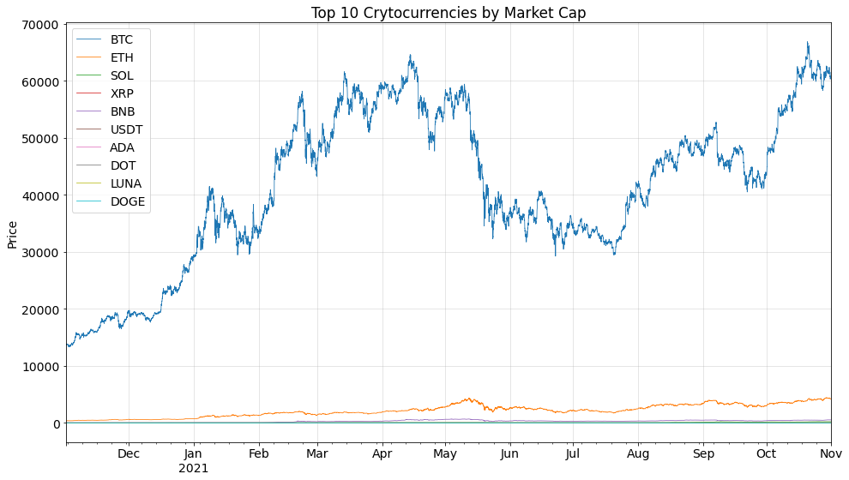

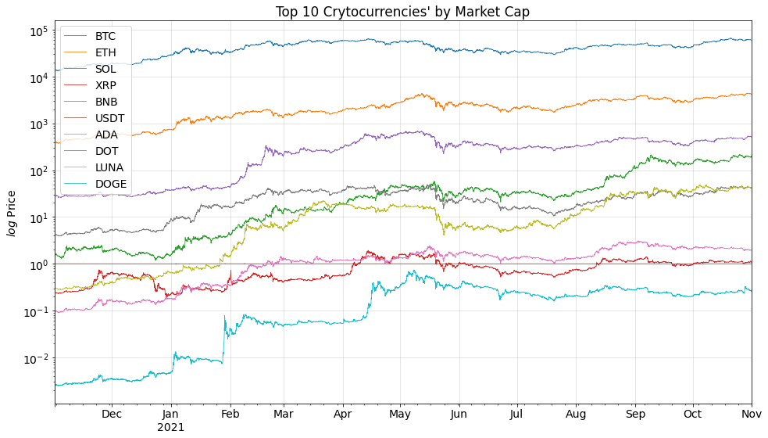
Data
In this project we use two different datasets:
Historical hourly crypto price for top 9 Coins (Ranked by market cap) + Dogecoin for six months duration. The data source is Crypto Compare [14].
17/34

Slide 18
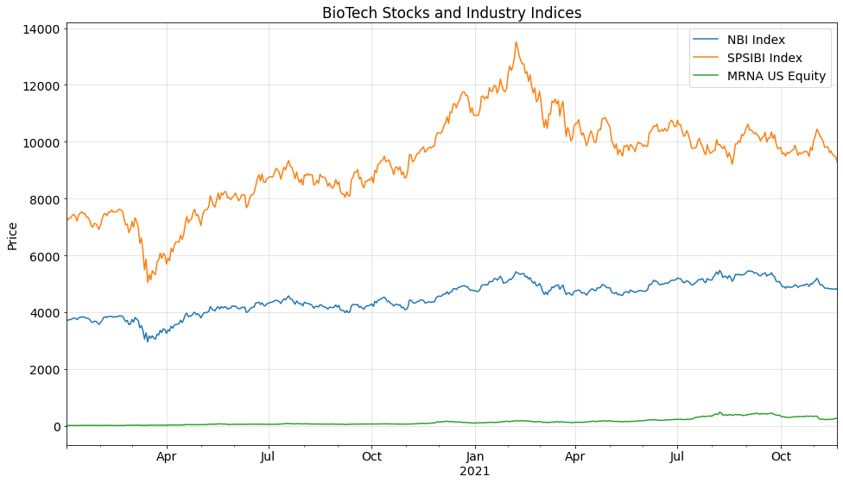
Data
2. Biotech Stock Market data is brought from Bloomberg:
Indices
DJI Index: Dow Jones Industrial Average. 30 prominent companies listed on stock exchanges in the United States.
SPX Index: Standard and Poor's 500. 500 large companies listed on stock exchanges in the United States.
NBI Index: NASDAQ Biotechnology Index. 213 Biotechnology or the Pharmaceutical industry companies listed on NASDAQ.
SPSIBI Index: S&P Biotechnology Select Industry Index. The biotechnology sub-industry portion of the S&P Total Markets Index (S&P TMI).
US Equities
PFE US Equity: Pfizer Inc. American multinational pharmaceutical and biotechnology corporation headquartered on 42nd Street in Manhattan, New York City.
MRNA US Equity: Moderna Inc. Pharmaceutical and biotechnology company based in Cambridge, Massachusetts that focuses on RNA therapeutics, primarily mRNA vaccines.
JNJ US Equity: Johnson & Johnson. Consumer Health, Pharmaceutical, and Medical Devices.
18/34

Slide 19
Results Structure
In this part, we go over the results for each method discussed and then compare them to benchmark by doing some Back test. We assume we have 100 units as the initial equity, and all the results in this section are for k and h based on the literature. After slide 34, some of these results are brought for the other k and h strategy explained in slide 12.
Result structure is as follows:
1. CUSUM
a) Return
i. Montgomery CUSUM Model
This is the only case we bring the comparison for with/without Transaction Fees
ii. Literature CUSUM Model
b) Price/Residual based CUSUM (Handling the autocorrelation with ARIMA):
i. Montgomery CUSUM Model
ii. Literature CUSUM Model
2. EWMA
a) Return
b) Price/Residual based EWMA (Handle autocorrelation with ARIMA)
3. Risk-adjusted CUSUM for stock market data
4. Back test
19/34

Slide 20
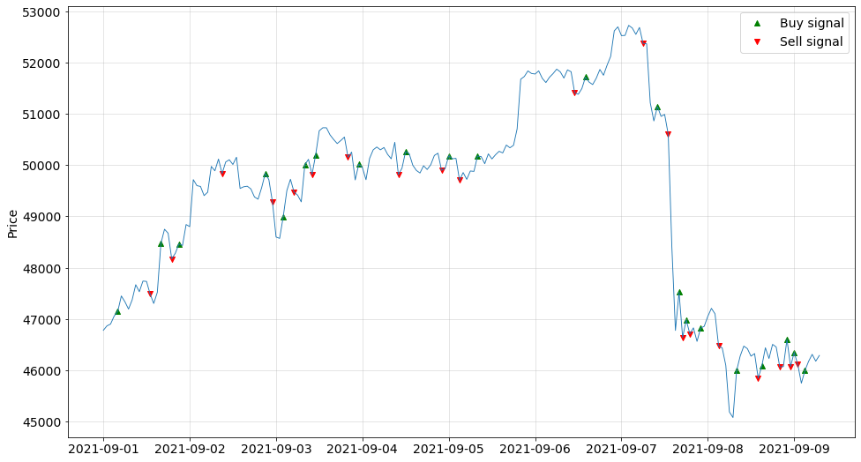
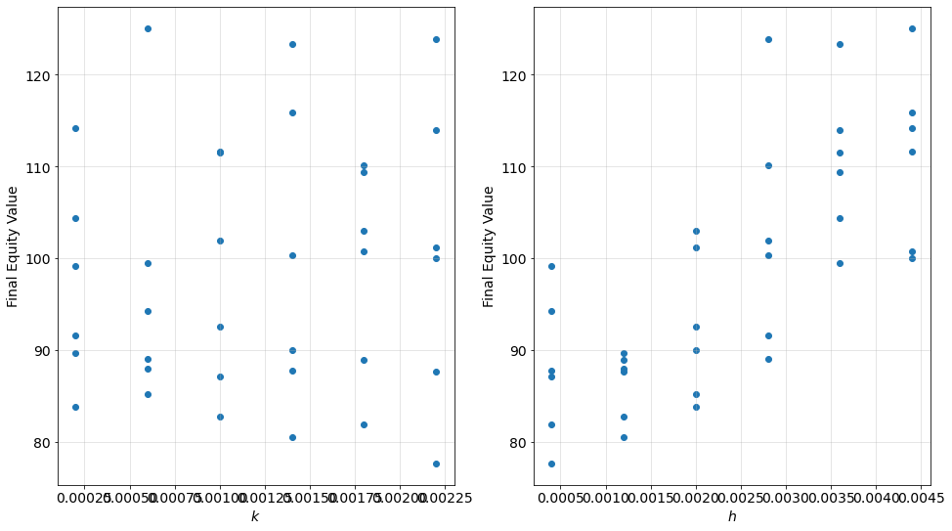
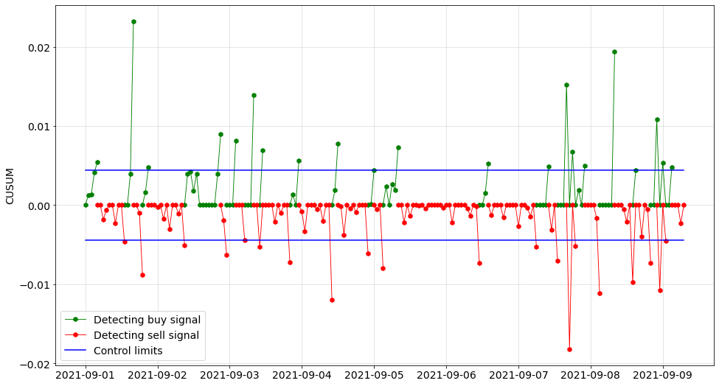
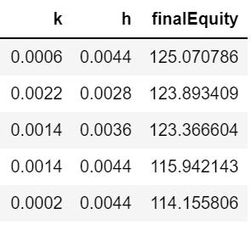
Results
1-a-i. CUSUM Method
Based on Return feature
Montgomery model
Without Transaction fees
%25 Profit!
20/34

Slide 21
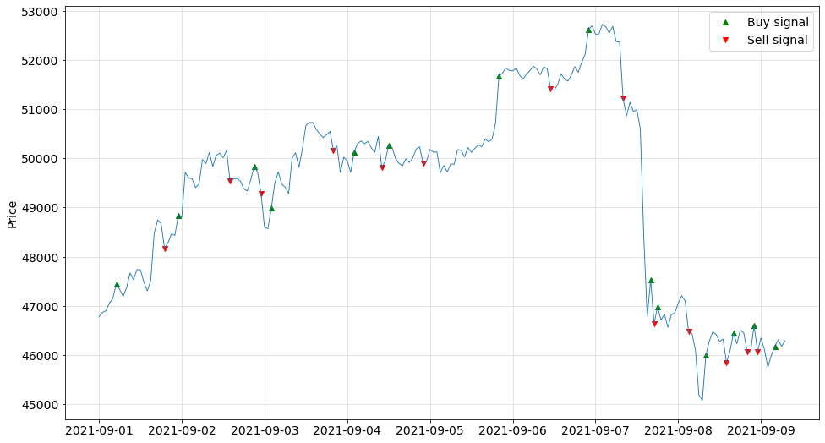
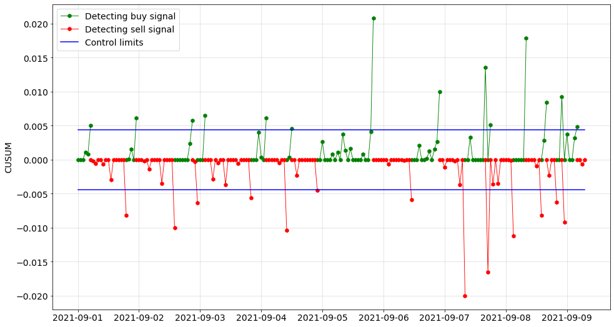
1-a-i. CUSUM Method
Based on Return feature
Montgomery model
With Transaction fees
Transaction Fee = %0.5
As compared to the previous model (without transaction fees), we can see the deterioration of the strategy by considering the transaction fees.
21/34

Slide 22
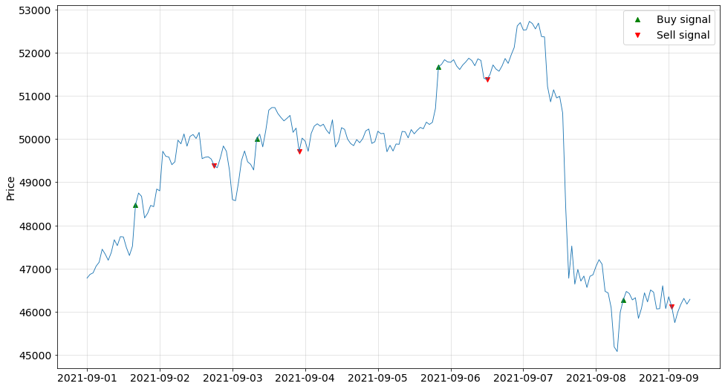
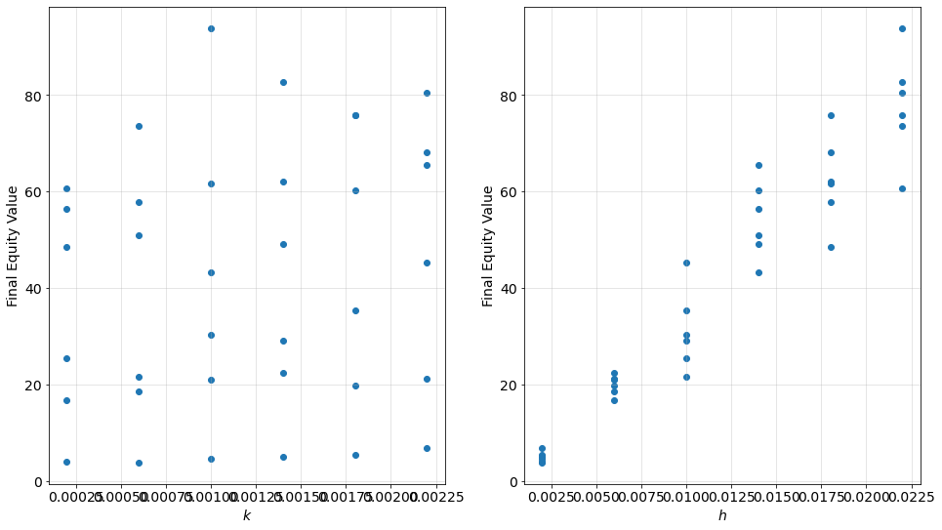
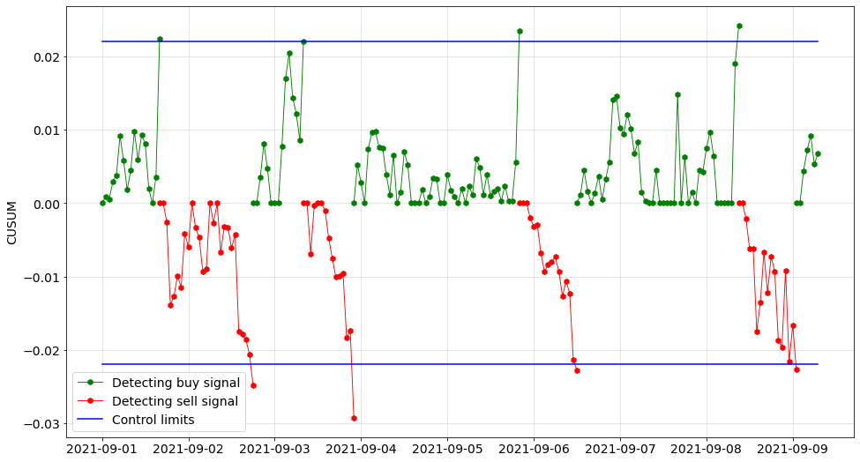
Results
1-a-ii. CUSUM Method
Based on Return feature
Literature model
22/34

Slide 23

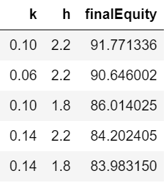
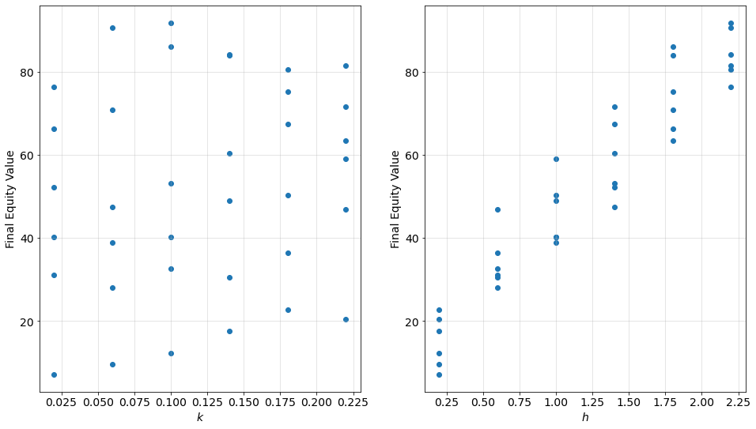
Results
1-b-i. CUSUM Method
Based on Residuals feature
(Residual Based CUSUM)
Montgomery model
23/34

Slide 24
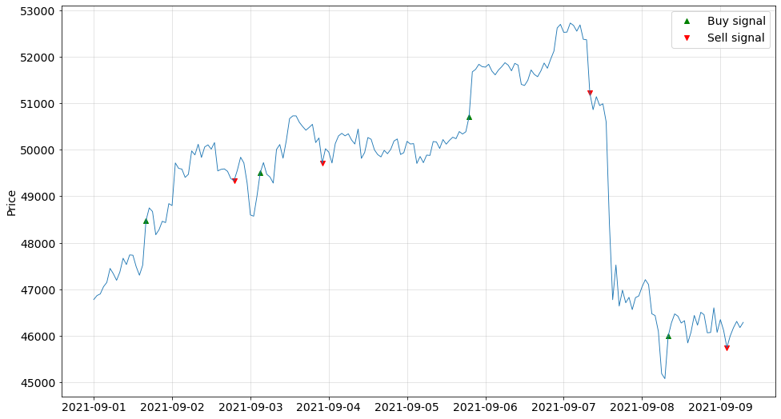
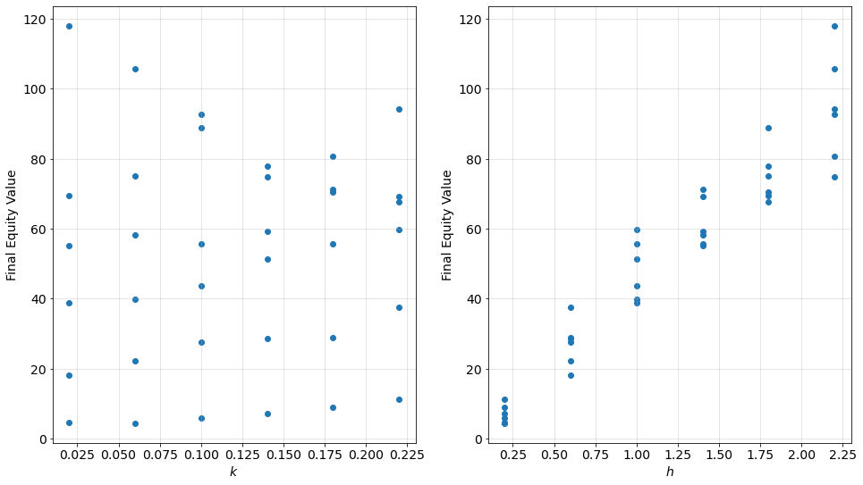
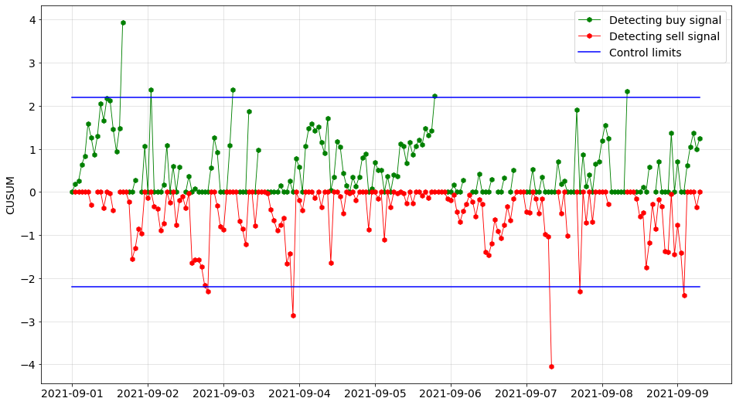
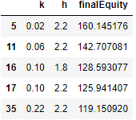
Results
1-b-ii. CUSUM Method
Based on Residuals feature
(Residual Based CUSUM)
Literature model
%60 Profit!
24/34

Slide 25
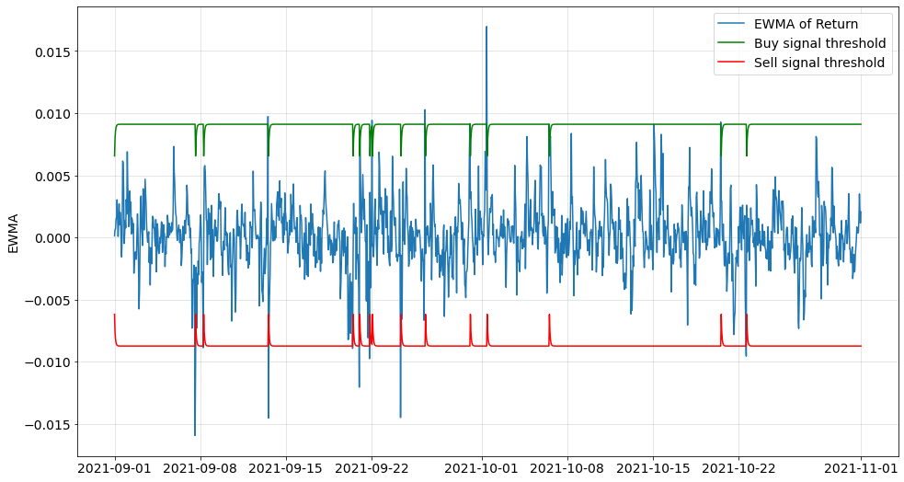
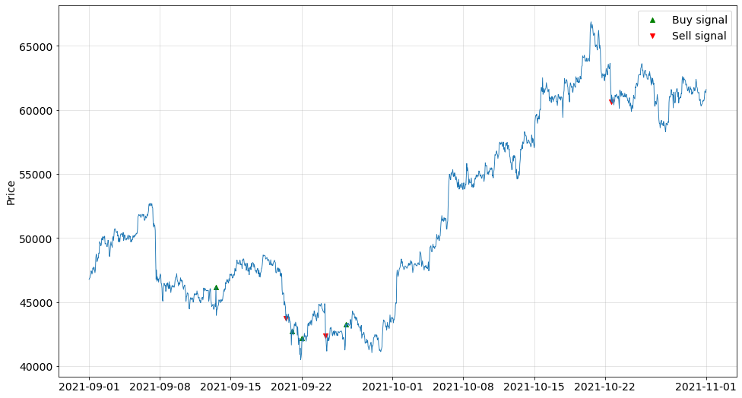
Results
2.a) EWMA Method
Based on Return feature
25/34

Slide 26
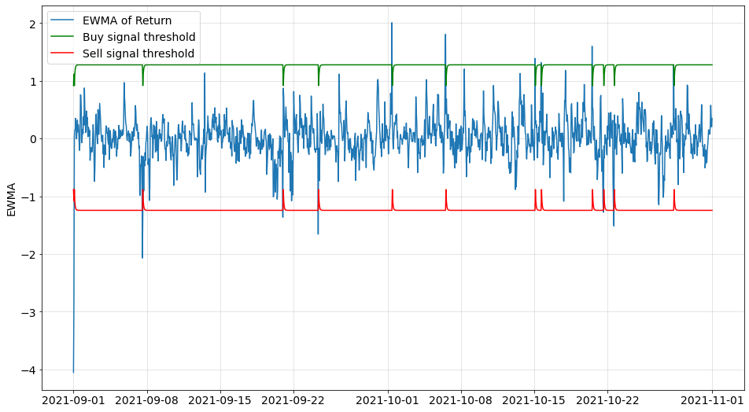
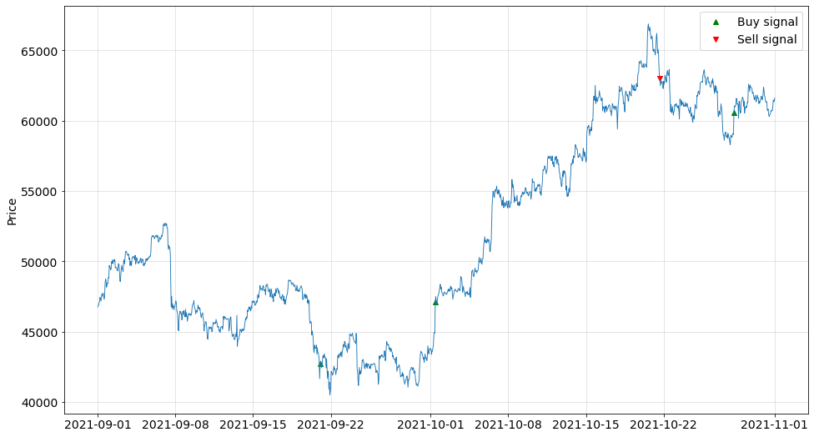
Results
2.b) EWMA Method
Based on Residuals feature
(Residual based EWMA)
26/34

Slide 27
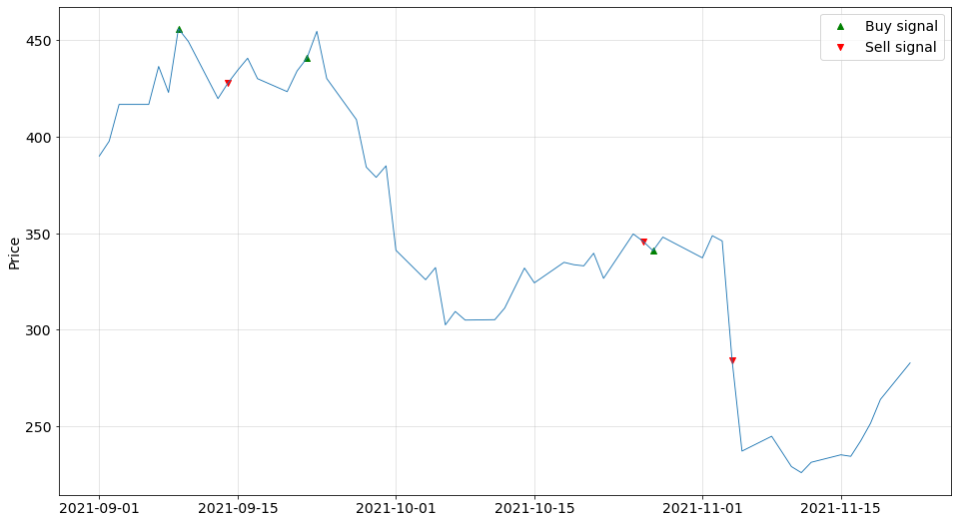
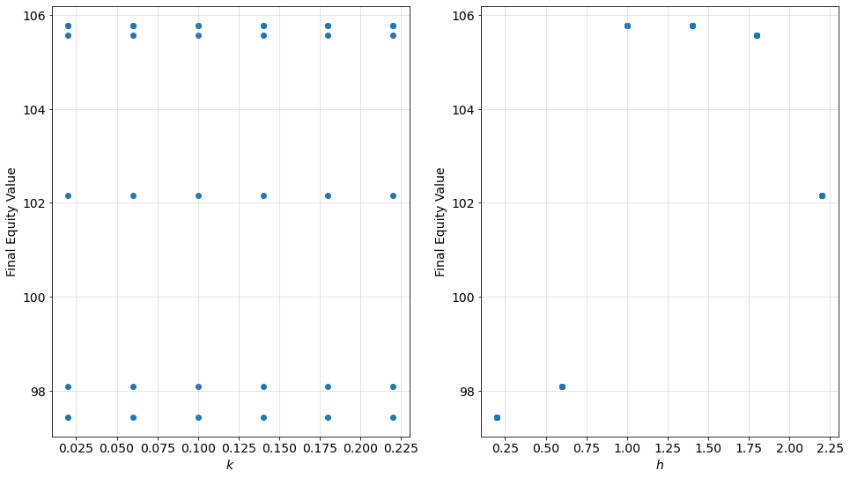
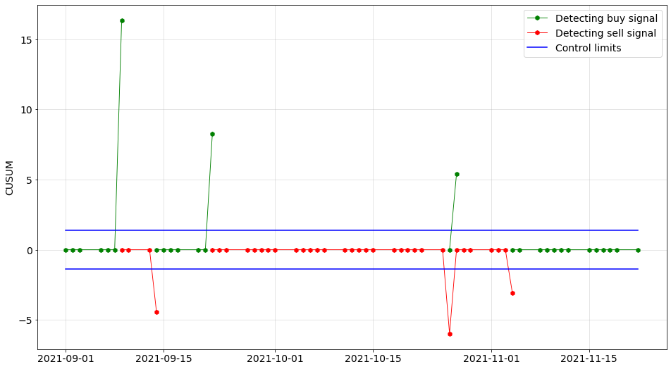
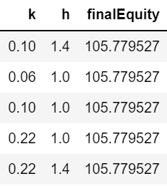
Results
3. Risk adjusted CUSUM
Stock Market Data
27/34

Slide 28
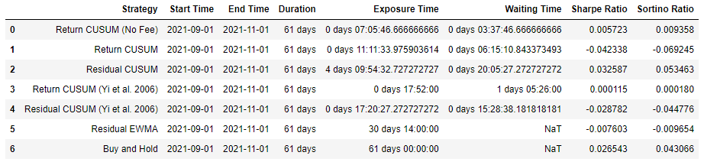
Results
4. Back test:
Ratio Table (ARL):
Average Exposure Time: ARL for sell signal
Average Waiting Time: ARL for buy signal
Sharpe Ratio: Risk adjusted return (Extra return on holding a risky asset)
Sortino Ratio: Downside risk adjusted return (Better indicator)
➔ Residual CUSUM model has best premium according to Sharpe ratio and Sortino ratio.
28/34

Slide 29
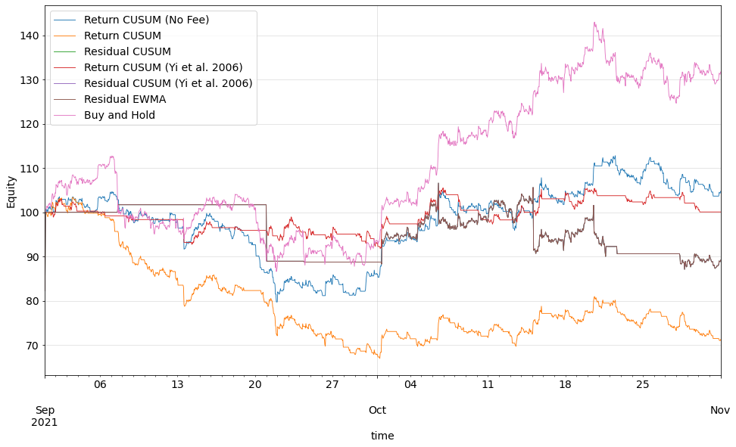
Results
4. Back test:
Equity Plot:
➔ Benchmark (buy-and-hold strategy) is outperforming all the discussed methods in terms of the final equity. After benchmark strategy, Montgomery CUSUM model based on return values without transaction fees is working better than the other methods and we can make some money in this holding period.
29/34

Slide 30
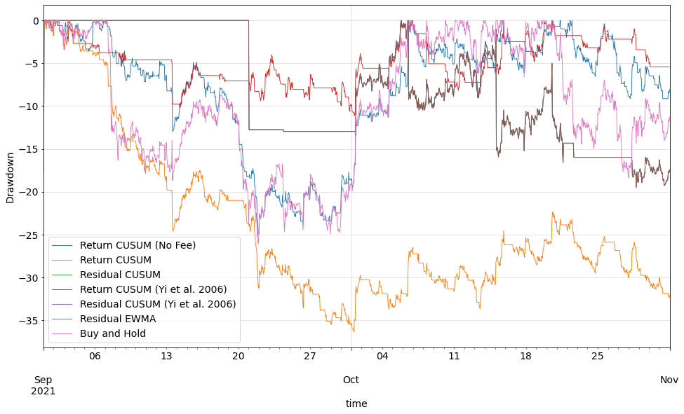
Results
4. Back test:
Drawdown plot:
➔ Return CUSUM (No Fee) and Return CUSUM (Yi et al. 2006) has better performance for risk-avoiders.
30/34

Slide 31
Main Conclusion: a) Control chart-based strategies, although not always, but in some cases and periods, can be profitable, and significantly reduce the risk while holding the asset. b) For Bitcoin Residual-based CUSUM model outperformed the benchmark in excess return. c) In terms of the Final Equity, non of the models could perform better than the benchmark.
Findings
Strength and Shortage of applied method: a) We developed a fully automated API to test for best control chart-based trading strategy for given coin. b) Our results outperformed benchmark in key risk factors. c) First time applied these methods to cryptocurrency market. d) Innovative way of applying risk-adjusted chart for industry trend. e) h is symmetric in our study. In real market, asymmetric limits may be used. f) Transaction cost structure is oversimplified in our model.
31/34

Slide 32
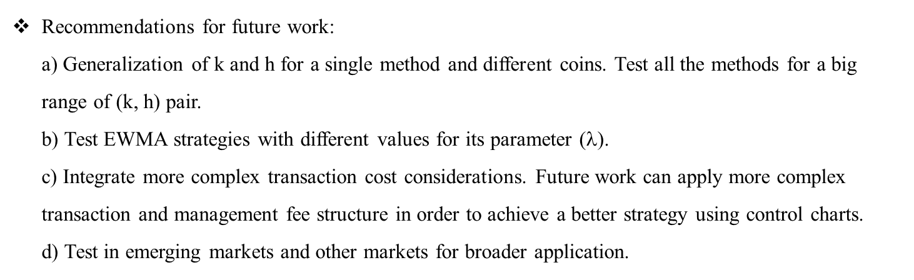
Applicational insights: a) Do transaction fees always lead to loss? No! Insights: Transaction fee affects a lot! In reality, Transaction fee is much more complicated than a fixed rate [15]. b) CUSUM can still work by increasing k and h, which means reducing trading frequency (and hence, avoiding transaction fees) and making profit. As we increase the value of h, our methods will be closer to the benchmark, which is the buy-and-hold strategy, and if the magnitude of h would be greater than the positive and negative values of C’s, it will be the same strategy as the benchmark.
Findings
Recommendations for future work: a) Generalization of k and h for a single method and different coins. Test all the methods for a big range of (k, h) pair. b) Test EWMA strategies with different values for its parameter ($$). c) Integrate more complex transaction cost considerations. Future work can apply more complex transaction and management fee structure in order to achieve a better strategy using control charts. d) Test in emerging markets and other markets for broader application.
32/34

Slide 33
References
[1] https://www.investopedia.com/terms/b/blockchain.asp
[2] https://www.investopedia.com/terms/v/virtual-currency.asp
[3] https://www.investopedia.com/terms/c/cryptocurrency.asp
[4] Roberts HV. Stock-market “patterns” and financial analysis: methodological suggestions. J Finance. 1959;14(1):1-10.
[5] Hubbard CL. A control chart for postwar stock price levels. Finance Anal J. 1967;23(6):139-145.
[6] Alexander SS. Price movements in speculative markets: trends or random walks. Ind Manage Rev. 1961;2(2):7-26.
[7] Alexander SS. Price movements in speculative markets-trends or random walks, number 2. Ind Manage Rev. 1964;5(2):25–46.
[8] Lam K, Yam H. CUSUM techniques for technical trading in financial markets. Finance Eng Jpn Markets. 1997;4(3):257-274.
[9] Yi. G, Coleman S, Ren Q. CUSUM method in predicting regime shifts and its performance in different stock markets allowing for transaction fees. J Appl Stat. 2006;33(7):647-661.
[10] Žmuk B. Capabilities of statistical residual-based control charts in short-and long-term stock trading. Naše gospodarstvo/Our Economy
2016;62(1):12-26.
[11] Xin L, Philip L, Lam K. An application of CUSUM chart on financial trading. Ninth International Conference on Computational Intelligence
and Security. IEEE; 2013:178-181.
[12] Montgomery DC. Introduction to Statistical Quality Control. Wiley; 2007.
[13] https://help.coinbase.com/en/coinbase/trading-and-funding/pricing-and-fees/fees#
[14] https://www.cryptocompare.com/
[15] https://help.coinbase.com/en/pro/trading-and-funding/trading-rules-and-fees/fees
33/34

Slide 35
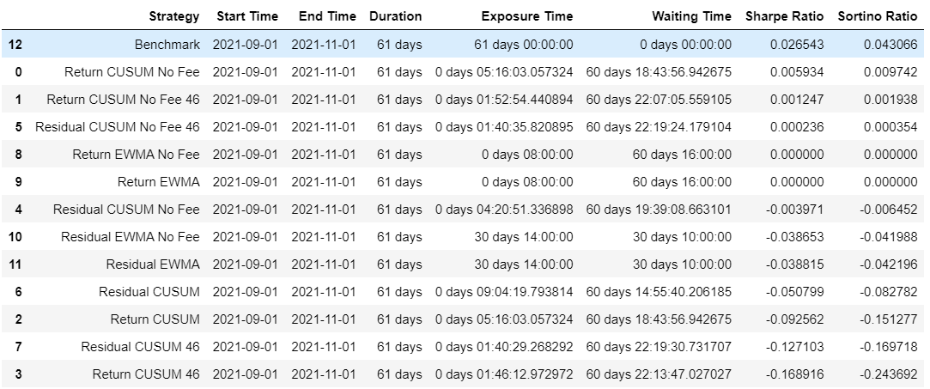
From this slide, we can see some results for the second k and h strategy (median strategy):
As can be seen, Benchmark outperformed our discussed methods in terms of Sharpe and Sortino Ratio fr this strategy.

Slide 36
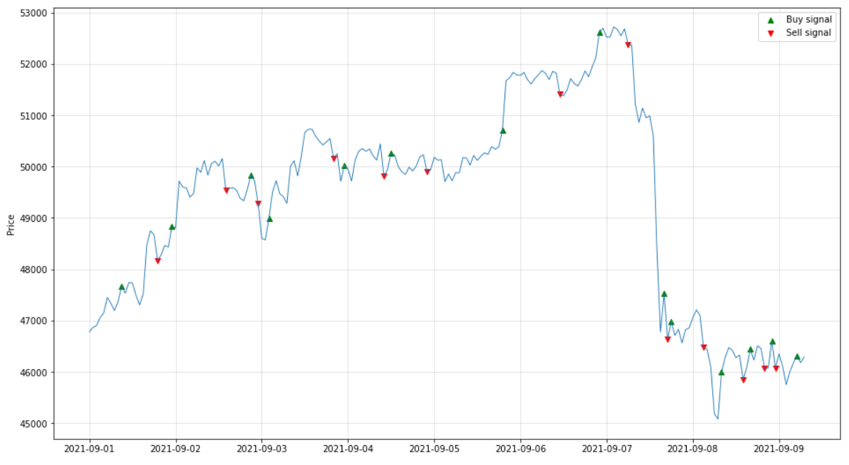
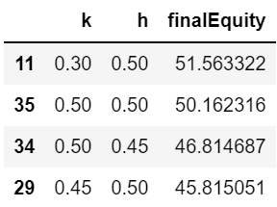
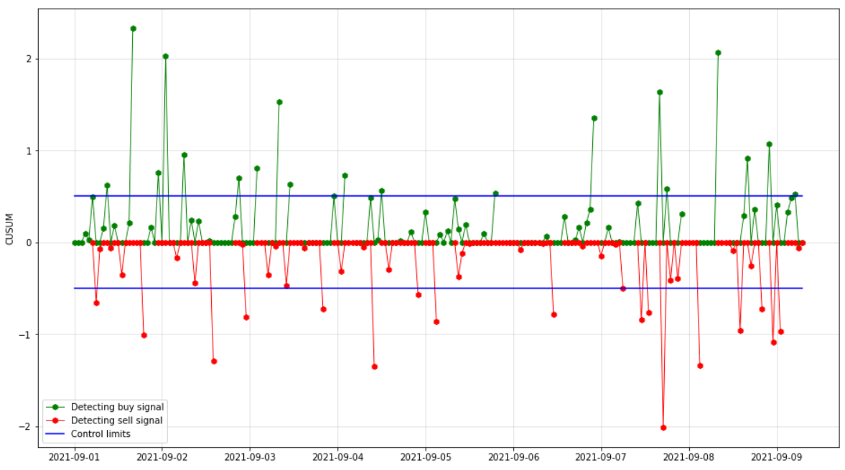
CUSUM Method
Based on Residuals feature
(Residual Based CUSUM)
Montgomery model
If we compare this model for these two k and h strategies, we can see that we had better results for the previous strategy of k and h (slide 23).
It is because we are doing less transactions and hence, we are losing less money.

